Slide 1
Manhattan Real Estate Purchase Price correlation to Neighborhoods and surrounding Venues
Elnatan Mataev

Slide 2
Problem statement
Main question:
Is there a correlation between the type and number of venues in a specific neighborhood in Manhattan to its residential real estate cost?
Sub questions – other factors that impact the cost of housing
Can we predict the cost of a residential unit in Manhattan based on its neighborhood?
Impact of residential type on its price
What is cost per square foot in Manhattan?
Does an elevator make a difference to the cost of the residential unit? How much?

Slide 3
Dataset:
Manhattan 2019 tax database on property sales tax (available online).
Foursquare venues open-source
Total of 16473 data entries → 16,473 transactions related to property purchases only in Manhattan on 2019 (Residential and commercial combined).

Slide 4
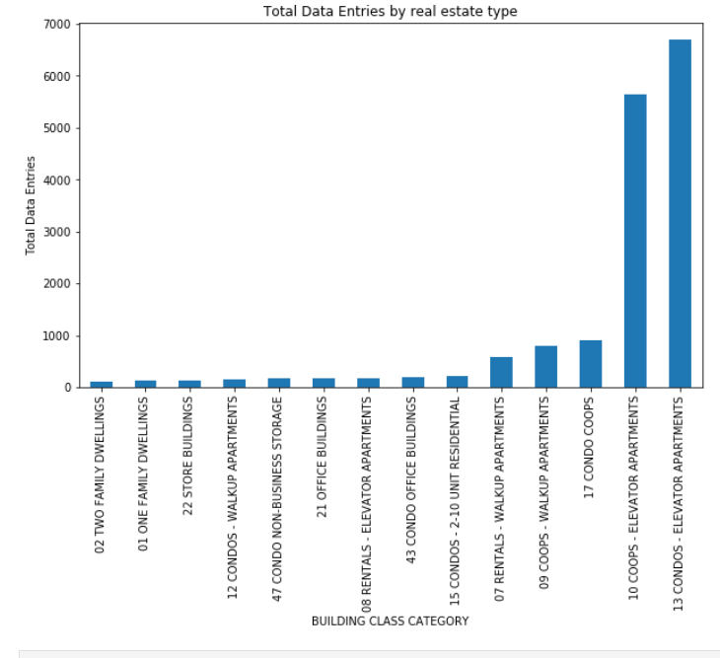
Total number of data entries by real estate building class category
As anticipated – NYC has mostly apartment and co-op
Very little one family or two families dwelling.

Slide 5
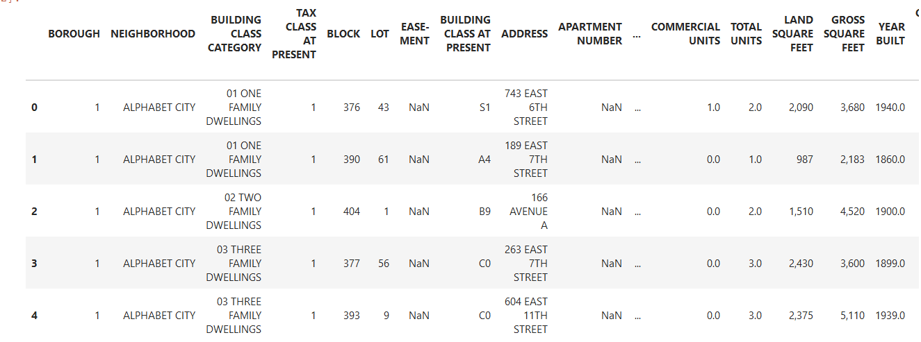
Example of data t able as received from NYC real estate data base - 2019

Slide 6
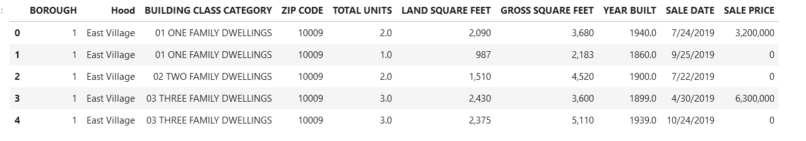
Real-estate data – post data cleanup
In this work- neighborhood, sale price, building class category, total unit and gross square feet is taken into account
Sale price =0 was dropped from the dataset.
Only residential properties were taken into account. Commercial property sales were not considered.

Slide 7
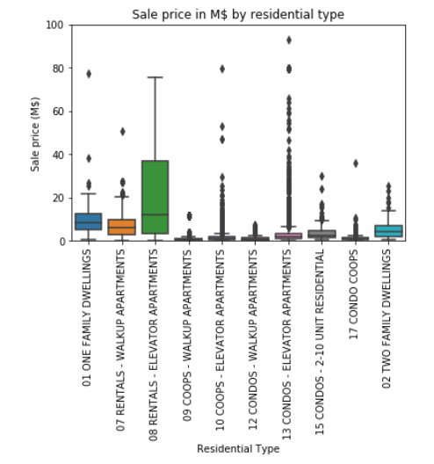
Sale price vs. residential type
Rentals properties (properties for rental purposes shows the most expensive sale price.
Reason – multi-units under the same building (same purchase)
Solution – normalizing the sale prices by the number of units

Slide 8
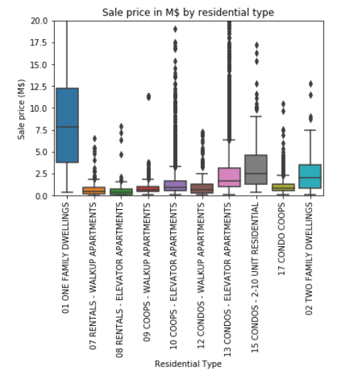
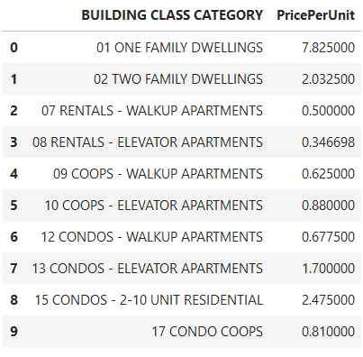
Sale price per unit vs. residential type
As anticipated – Single family and 2 family dwelling is the most expensive in NYC and not very common.
Elevator condos and co-ops worth more than non-elevator. Adding roughly 200K$ (co-op) -1M$ (condo) to its value.
Elevator did not add value to rental property

Slide 9
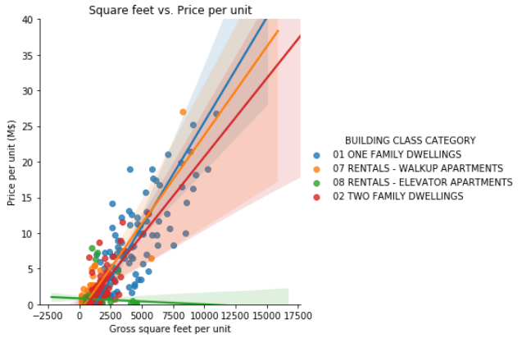
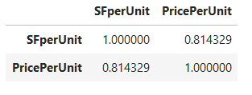

Gross square feet vs. real-estate price per unit
Strong linear correlation between the size of the property to its price with 0.814 R²
Slope = 0.002 in other words 1 square feet in Manhattan costs roughly 2000$.
Very high cost per square foot.

Slide 10
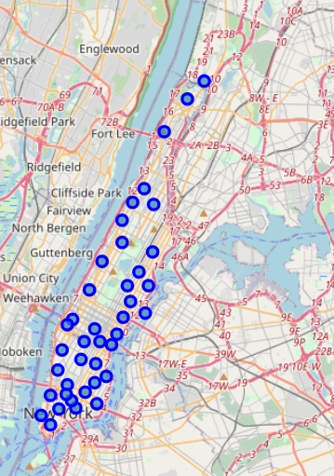
Neighborhoods locators based on Foursquare database
Manhattan neighborhood latitude and longitude coordinates were taken from Foursquare open-source database.
Neighborhood name was used as identifier.

Slide 11
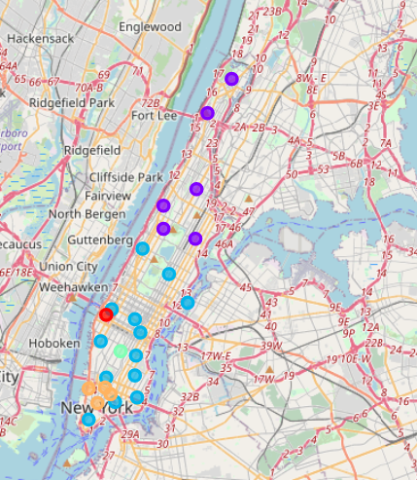
Manhattan median real-estate purchase price by neighborhood
Cluster 1 – Median price per unit < 0.75 M$ (purple)
Cluster 2 – 0.75< Median price per unit < 1.5 M$ (blue)
Cluster 3 – 1.5< Median price per unit < 2.25 M$ (cyan)
Cluster 4 – 2.25< Median price per unit < 3 M$ (orange)
Cluster 5 – Median price per unit > 3 M$ (red)
North Manhattan – more affordable housing – residence are typically working-class lower income families
Financial district area – expensive high-end housing. Typically residents work in the surrounding financial institutions → High income
Cluster 5- Hudson Yards –
Most expensive.
Recently renovated and developed.
Top notch shopping centers, parks and facilities
High-end houses with unique design

Slide 12
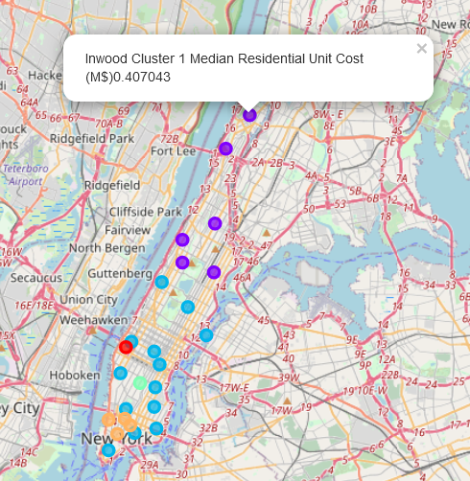
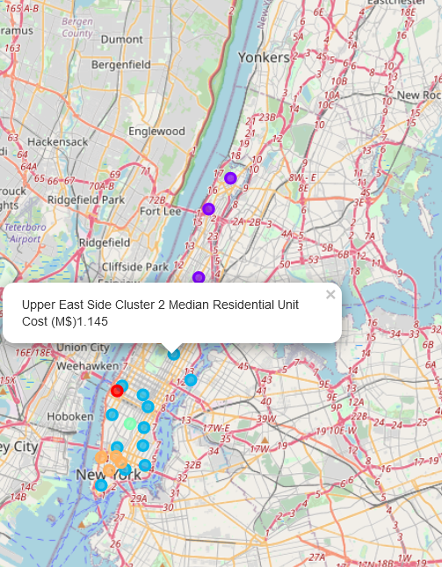
Manhattan median real-estate purchase price by neighborhood – interactive map
5 clusters by median price
Popup shows the median real-estate price, and the cluster

Slide 13
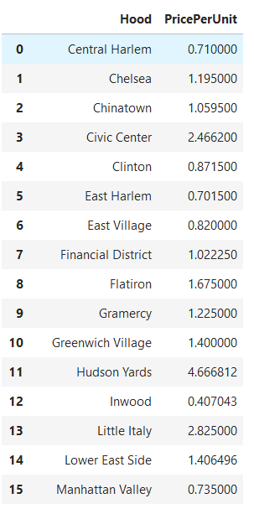
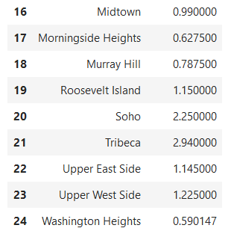
Manhattan median real-estate purchase price by neighborhood – summary table

Slide 14
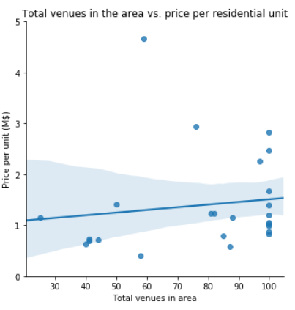
Correlation between total number of venues in neighborhood to its housing cost
Foursquare was used to extract the total amount of venues per neighborhood
Slight correlation between the two factor.

Slide 15
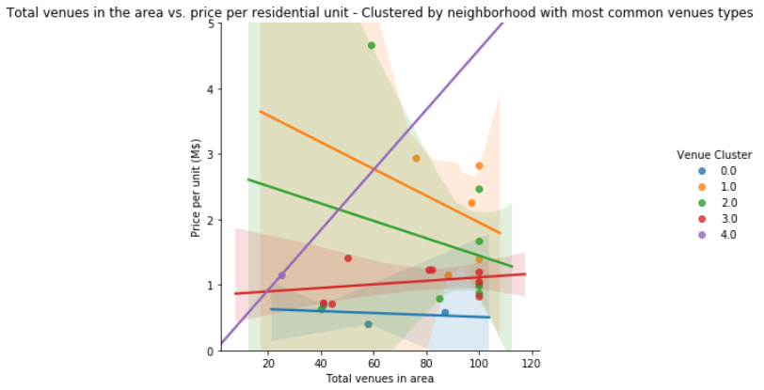
Neighborhood Venue Type cluster vs. Housing Cost
2nd type of clustering in this work.
Top 5 frequent venues in each neighborhood were considered and neighborhood were clustered accordingly.
Clear separation in price vs. venue type cluster
Strong correlation between venue type cluster and housing costs

Slide 16
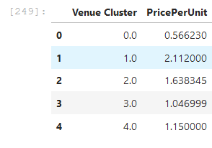
Neighborhood Venue Type cluster vs. Housing Cost
Venue type cluster 0 → low end housing which are cheaper to buy.
Indeed the cluster 0 neighborhood are located in north Manhattan which has more affordable housing and typically has low-income families.
In the top 5 venues – every day food such as Mexican restaurants, Deli and bakeries.
Venue type cluster 3→ Mid-range housing that are a little bit pricier than cluster 0.
All offer similar types of venues at similar price-point.
More mid-income venues such as bars, art galleries, desert shops, ice cream shops
Venue type cluster 2→ Larger price variation across the neighborhoods .
If a buyer is interested in cluster 2 venues types, one can choose an apartment in a cheaper area that offers similar types of venues.
Venues include Wine-bars, hotels, coffee shops and fitness centers
Venue type cluster 1→ High-end neighborhoods that is reflected in high-cost housing with a median cost of 2.11 M$
Includes high end venues such as parks, comedy clubs, spas and sushi restaurants.

Slide 17
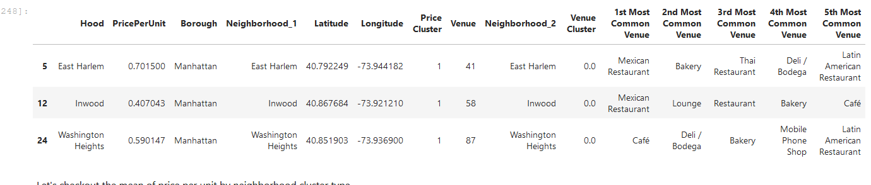
Cluster 0

Slide 18
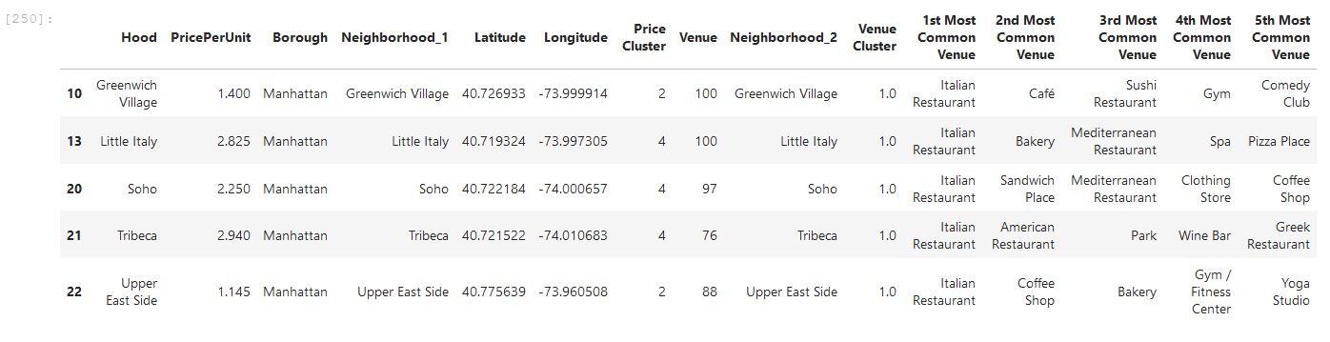
Cluster 1

Slide 19
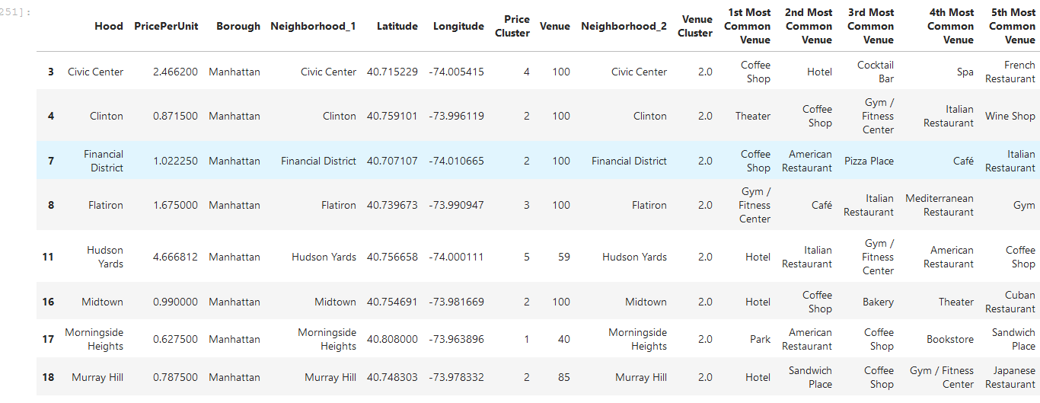

Slide 20
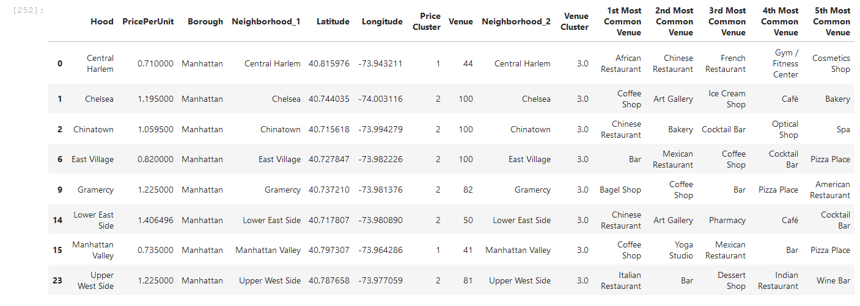
Cluster 3

Slide 21
Cluster 4

